Slide 1


STAT 248
Predicting Flu Trends Using Google Search Data
High-Dimensional Regression with Ridge and Lasso
Analysis
of
Time Series
Yirong Huo
May 2025

Slide 2
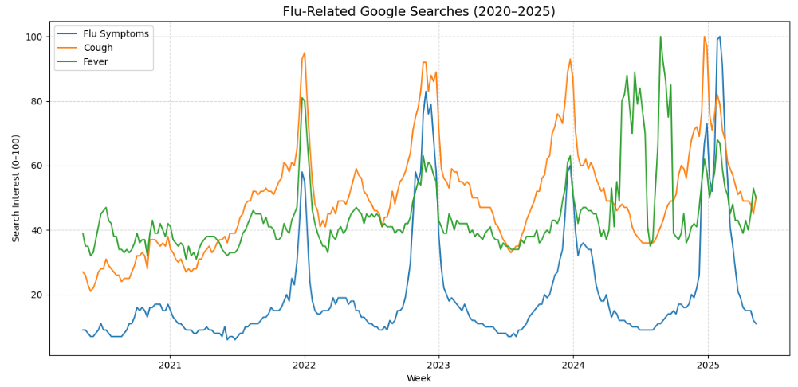

• Seasonal flu outbreaks affect millions each year with potential of straining healthcare systems.
• Traditional flu surveillance methods have reporting lags.
• Google search trends offer a faster and real-time view of public health behavior.
• Modeling search interest can help predict flu activity before official data arrives.
Motivation

Slide 3

B
a
c
k
g
r
o
u
n
d
Prior Work on Flu Prediction
Google Trends helps early prediction of flu by capturing public search behavior (Chen et al., 2018).
Combining Google Trends and temperature data improved influenza outbreak prediction, enabling earlier warnings (Zhang et al., 2018).
Modified Ridge Regression produced the lowest prediction error among all models tested for influenza forecasting in Ireland (Yadav and Agarwal, 2020).
Web searches on common cold reliably predicted asthma cases across multiple countries (Sousa-Pinto et al., 2021).

Slide 4

C
o
n
t
e
x
t
Study | Data Source | Method | Key Insight
Chen at al. | Google Trends | Linear Regression | Early flu prediction feasible
Zhang et al. | Trends + Temp | Hybrid Model | Improved accuracy with external data
Yadav and Agarwal | CDC + Trends | Ridge Regression | Ridge had best perfromance
Sousa-Pinto et al. | Trends | Correlation | Search term predicts asthama

Slide 5




Research Focus
Lagged terms capture flu progression patterns
Search data reflects real-time health behavior
Using Google search data to track flu-related interest
Applying Ridge and Lasso to handle high-dimensional predictors of flu
Evaluating predictive accuracy vs. traditional baselines
Exploring the impact of lagged variables on flu trend modeling
Flu Prediction Using Search Trends
Ridge and Lasso enhance model accuracy

Slide 6
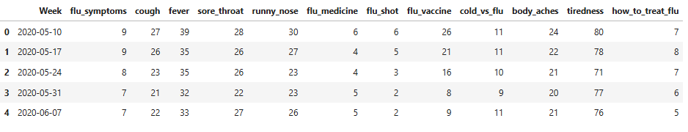
Excerpt of raw Google Trends data (top 5 weeks)
Weekly search data from Google Trends (2020–2025)
12 flu-related search terms (e.g., flu symptoms, fever, cough)
Target variable: flu_symptoms
Unit of measurement: Search interest (0–100 scale)
Data and Variables

Slide 7


Data Processing
Steps to transform raw search data into modeling-ready inputs
Cleaned Data
Lagged Features
Final Dataset
Raw Data
Removed missing values and standardized weekly timestamps
Created lagged predictors (up to 4 weeks) for each search term
Dropped rows with incomplete lagged values
Final dataset: 12 terms × 4 lags = 48 predictors

Slide 8



Modeling Approach
Lagged Search Terms (48 predictors)
Applied Ridge and Lasso regression to handle many correlated predictors
Both methods include regularization to reduce overfitting
Ridge keeps all variables; Lasso performs variable selection
Used 5-fold cross-validation to tune penalty strength (λ)
Ridge / Lasso Regression
Predicted Flu Activity (flu_symptoms)

Slide 9

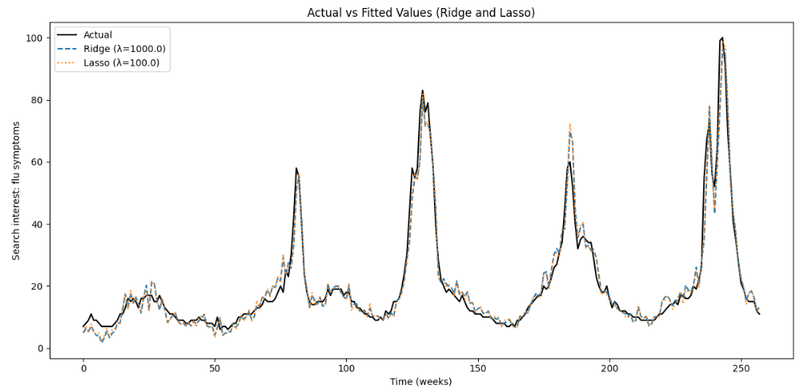
Model Fit Visualization

Slide 10
Model Performance Comparison
Metric | Ridge Regression | Lasso Regression
RMSE | 3.8135 | 3.6731
MAE | 2.4993 | 2.4650
R² Score | 0.9529 | 0.9563
Both models show strong predictive accuracy (R² > 0.95).
Lasso slightly outperforms Ridge on all metrics.
Regularization helps manage high-dimensional input data.

Slide 11
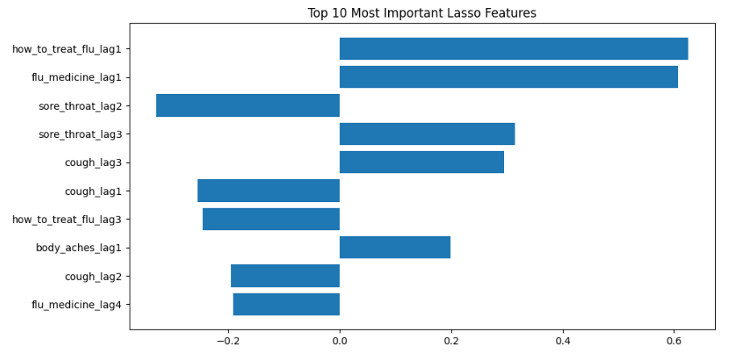
Important Predictors Identified by Lasso

Slide 12
Interpreting the Top Features
Lasso identified key flu-related terms with strong predictive power.
Top predictors include how to treat flu and flu medicine searches from 1–2 weeks prior.
Predictive signals emerge before symptoms peak, offering early warning potential.
Behavioral queries (e.g., treatment-related) are leading indicators of flu activity.

Slide 13
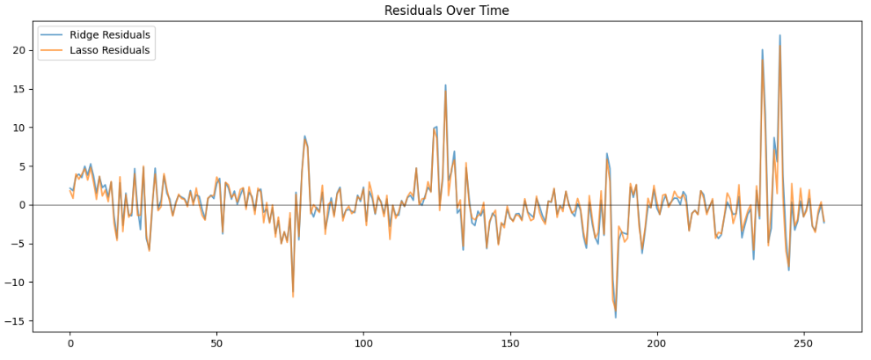
Residual Analysis
Residuals centered near zero
Lasso shows tighter error spread
No major trends or shifts
Models generalize well over time

Slide 14
Non-human Queries
Limitations
Search data ≠ confirmed flu cases
Influenced by media or seasonal noise
Lag window fixed at 4 weeks
No spatial or demographic features
Only flu-related search terms used
Curiosity
News
Influence
What could
a Google search mean?
Seasonality Confusion
Asynchronous Timing

Slide 15
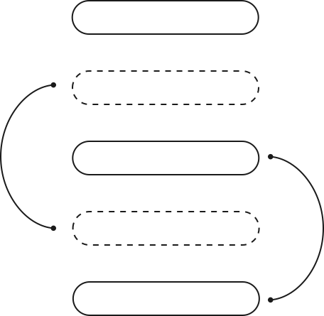
Future Directions
Incorporate Spatial Data
Integrate region-specific search trends to capture localized flu patterns.
Include age, gender, or population attributes to enhance model granularity.
Allow models to learn optimal time lags rather than fixing a uniform window.
Experiment with LSTMs or transformers for improved temporal predictions.
Combine search trends with confirmed flu case data for better accuracy and timeliness.
Demographic Features
Adaptive Lag Modeling
Deep Learning Models
Hybrid with CDC Data

Slide 16
Comparing with Prior Work
Used Ridge and Lasso, aligning with prior regularized approaches
Did not combine external signals like temperature (unlike Zhang)
Applied lagged predictors, extending temporal structure in modeling
Highlighted variable importance via Lasso, which prior studies didn’t emphasize
Achieved comparable or better performance (R² > 0.95) using only search data

Slide 17
Conclusion
Google search trends can effectively signal flu activity in real time.
Ridge and Lasso models achieved high predictive accuracy (R² > 0.95).
Lasso highlighted early behavioral signals like treatment-related queries.
Search data offers scalable, fast-response insights for public health.

Slide 18
STAT 248
Predicting Flu Trends Using Google Search Data
Analysis
of
Time Series
High-Dimensional Regression with Ridge and Lasso
Thankyou...
Yirong Huo
May 2025

Slide 19
References
Chen, T.-H., Chen, Y.-C., Chen, J.-L., & Chang, F.-C. (2018). Flu trend prediction based on massive data analysis. 2018 IEEE 3rd International Conference on Cloud Computing and Big Data Analysis (ICCCBDA). doi:10.1109/ICCCBDA.2018.8386532
Sousa-Pinto, B., Halonen, J. I., Antó, A., Jormanainen, V., Czarlewski, W., Bedbrook, A., . . . Bousquet, J. (2021). Prediction of Asthma Hospitalizations for the Common Cold Using Google Trends: Infodemiology Study. Journal of Medical Internet Research, 23(7), 1-15. doi:10.2196/27044
Yadav, S., & Agarwal, P. (2020). Influenza Prediction: Analyzing Machine Learning Algorithms. Asian Journal of Computer Science and Technology, 9(1), 14-18. doi:https://doi.org/10.51983/ajcst- 2020.9.1.2155
Zhang, Y., Bambrick, H., Mengersen, K., Tong, S., & Hu, W. (2018). Using Google Trends and ambient temperature to predict seasonal influenza outbreaks. Environment International, 117, 284-291. doi:https://doi.org/10.1016/j.envint.2018.05.016

